Slide 1
Perennials in our Garden
Native Plants and vegetables: varieties to encourage local diversity and promote wildlife and pollinators.

Slide 2
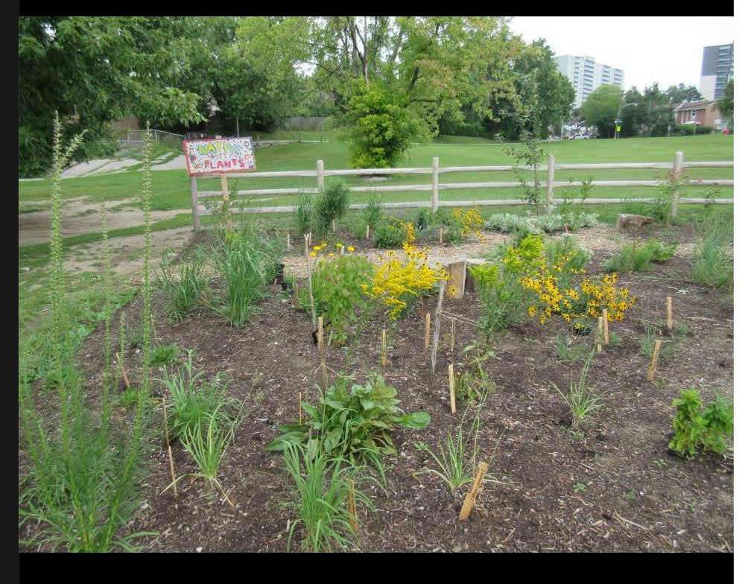
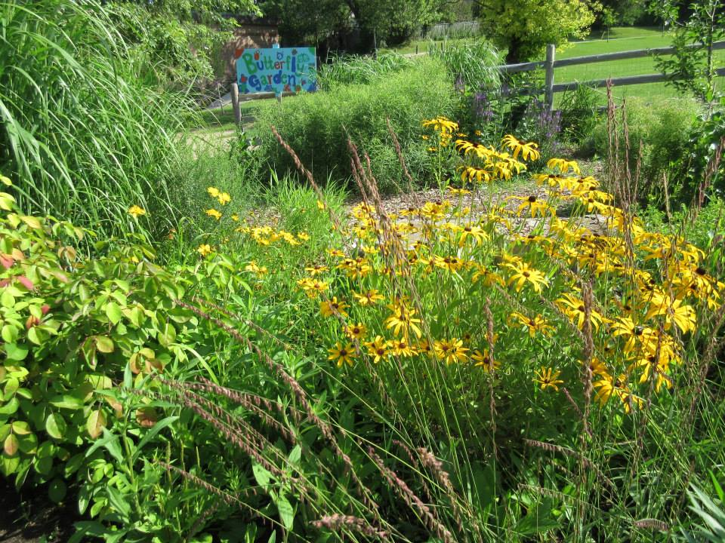
Native Garden and Perennials: Before and After 2 years

Slide 3
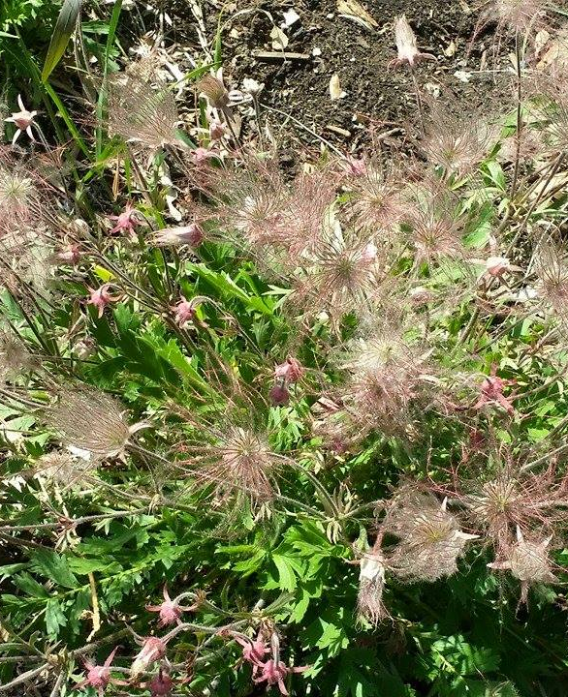
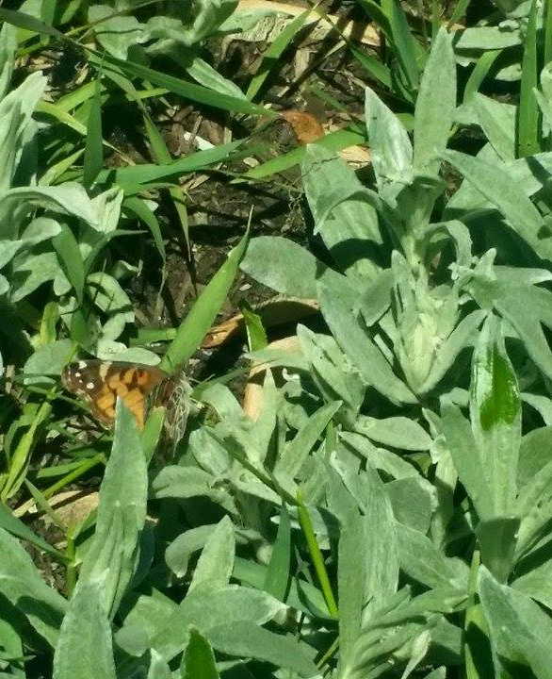
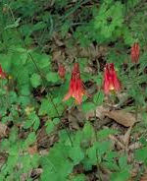
Prairie Smoke
Prefers sunny, well-drained soils, can withstand light shade
It is classed as endangered.
Pearly Everlasting
Host for American Painted lady and other pollinators
Drought tolerant
Columbine
It prefers partial shade with rich, well-drained soil.
Can tolerate dull sun under drier conditions.

Slide 4
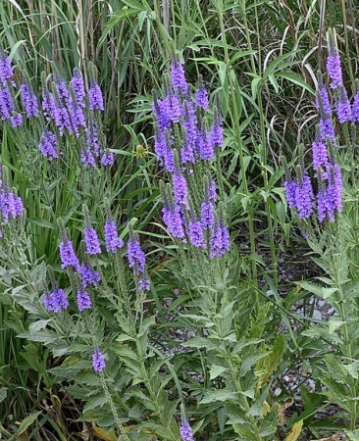
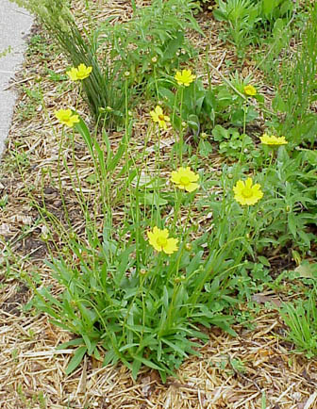
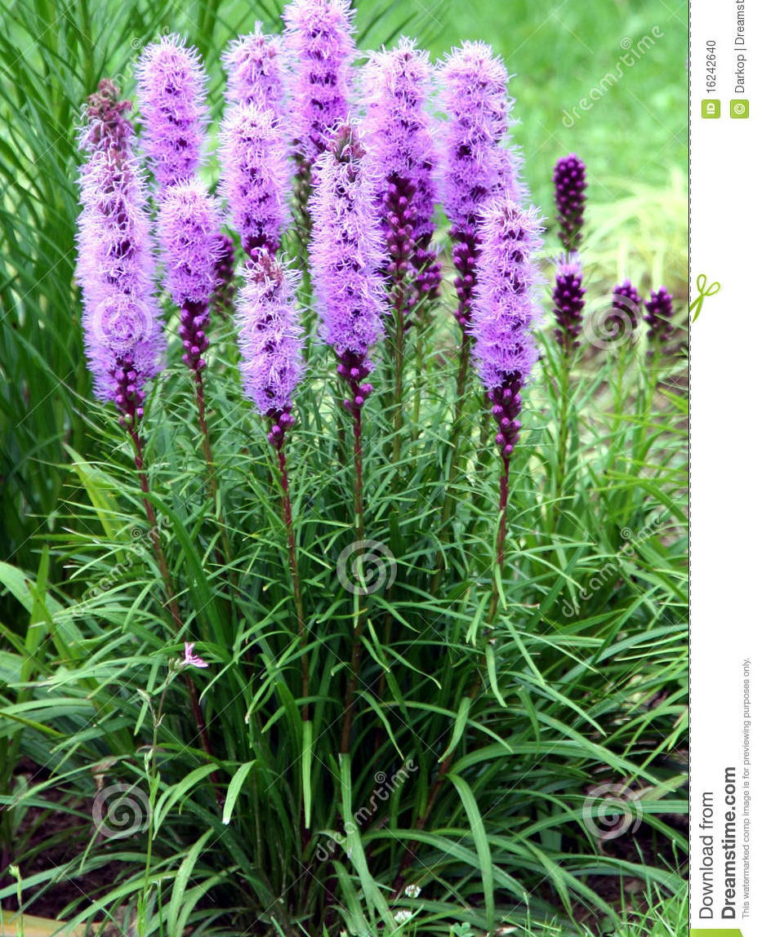
Hoary Vervain
Very drought resistant, blooms in late summer.
Leaves are larval host for Common Buckeye Butterfly.
Seeds important for birds and mammals.
Sand Coreopsis
Prefers full sun, can tolerate dry conditions dry conditions and poor soil.
Easy to grow from transplants.
Dense Blazing Star
Full Sun, Clay Soil
Species at risk.

Slide 5
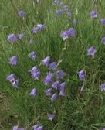
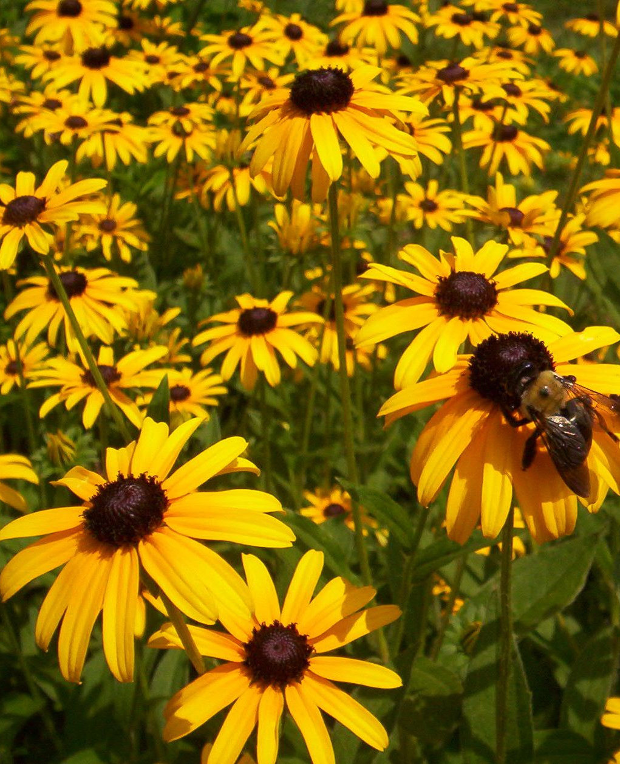
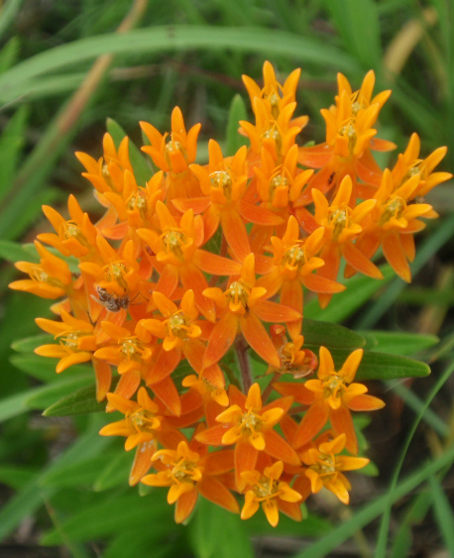
Harebell
These flowers are a good source for hummingbirds, insect pollinators and other beneficial insects.
Black-eyed Susan
Full to partial sun, fertile soil but can tolerate tough conditions.
Butterfly Milkweed
Full sun, difficult to grow in clay soil.
Attracts a wide range of beneficial pollinators.

Slide 6
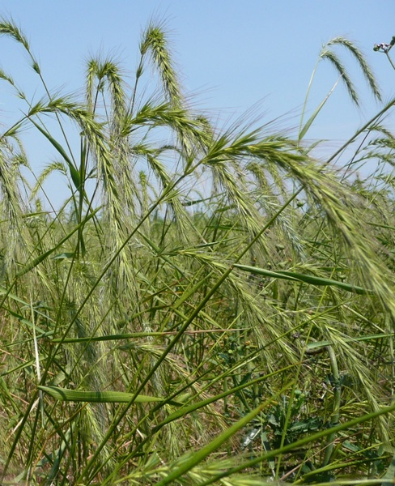
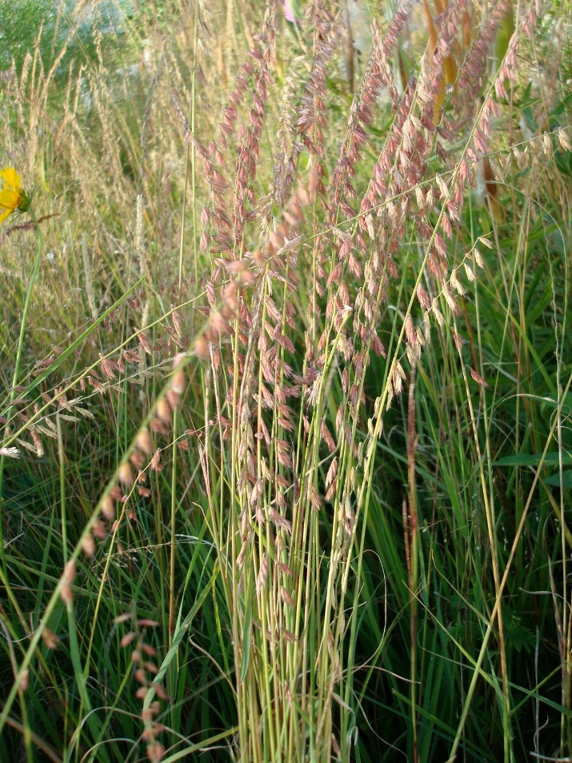
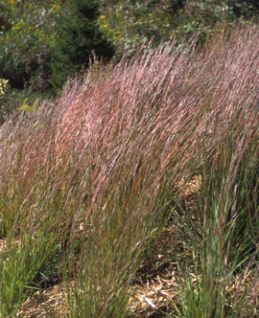
Canada Wild Rye
Prefers full sun to partial sun
Wildlife food and cover; ornamental
Sideoats Grama
Full Sun prefers sand/loam.
Attracts butterflies, pollinators, birds.
Little Bluestem
Full sun, welldrained soil, poor soil.
Makes stunning displays.

Slide 7
Perennial Grasses
Some of the native plants growing in our garden:
1. Common mountain mint Pycnanthemum virginianum
2. Wild columbine Aquilegia canadensis
3. Swamp milkweed Asclepias incarnata
4. Butterfly milkweed Asclepias tuberosa
5. Common milkweed Asclepias syriaca
6. Harebell Campanula rotundifolia
7. Blackeyed Susan Rudbeckia hirta
8. Dense blazing star Liatris spicata
9. Smooth Blue Aster Symphyotrichum laeve
10. Heath Aster Symphyotrichum ericoides
11. Grey Goldenrod Solidago nemoralis
12 Flat top fragrant goldenrod Euthamia graminifolia
13. Hoary Vervain Verbena stricta
14. Prairie Smoke Geum triflorum
15. Sand Coreopsis Coreopsis lanceolata
16. Pearly Everlasting Anaphalis margaritacea
17. Nodding Onion Allium cernuum1.
Sideoats grama Bouteloua curtipendula
2. Canada wild rye Elymus canadensis
3. Little bluestem Schizachyrium scoparium
4. Switch Grass Panicum virgatum

